Slide 1

WhiteBoard

Slide 2
What is WhiteBoard?
collaborative annotating tool
allow simultaneous annotators, with permission from host
with version control, which produces downloadable saved states

Slide 3
Main Components
Canvas – whiteboard
Toolbar - for annotation tools
Participants widget – manage editing permissions
Version control widget – to view the available saved states

Slide 4
Layout

Slide 5
Layout Idea 1

Slide 6








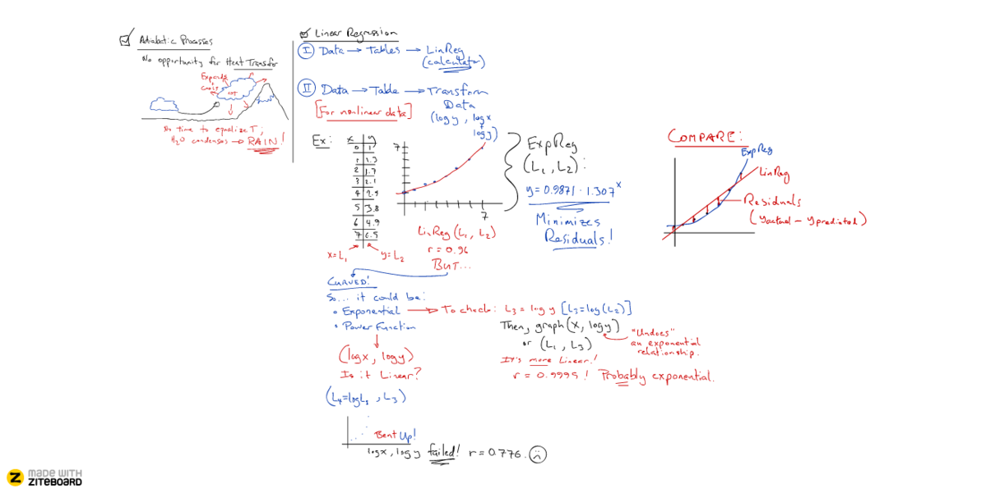












Checkpoint #10

Slide 8
Layout Idea 2

Slide 9
1 – Base Layout

Slide 10




Slide 12
2 – Host View

Slide 13






















Participants
#Host:Tutor
StudentA
StudentB

Slide 14
Checkpoints
Checkpoint #9
Checkpoint #10
Checkpoint #11

Slide 15
3 – Guest View

Slide 16
Participants
#Host: Tutor
StudentA
StudentB

Slide 17
Participants
#Host: Tutor
StudentB
StudentA

Slide 18
Checkpoints
Checkpoint #9
Checkpoint #10
Checkpoint #11

Slide 19
Use Case: Class Discussion

Slide 21
Participants
#Host:Tutor
StudentA
StudentB

Slide 22

8

Slide 23
8

Slide 24

Checkpoints
Checkpoint #0
8

Slide 25
Checkpoints
Question
8

Slide 26
Participants
#Host:Tutor
8
StudentA
StudentB

Slide 27

8
7

Slide 28
8
7

Slide 29
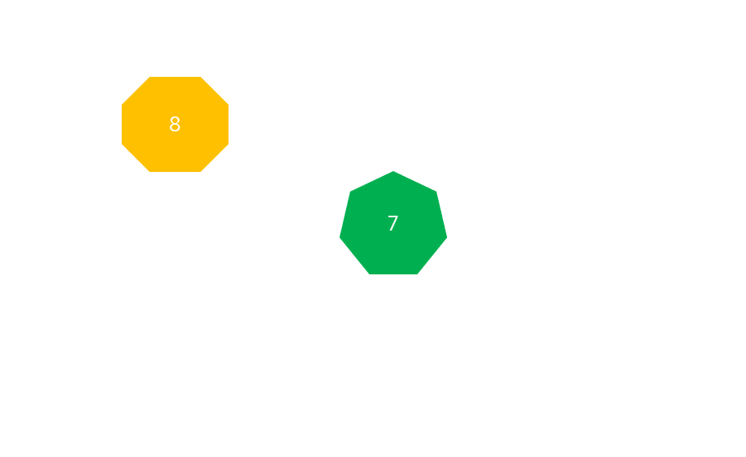
Checkpoints
Question
8
7
Checkpoint #1

Slide 30
Checkpoints
Question
8
7
Student A’s answer

Slide 31
Checkpoints
Question
8
7
Student A’s answer

Slide 32
8

Slide 33
Participants
#Host:Tutor
8
StudentA
StudentB

Slide 34

8
6

Slide 35
8
6

Slide 36
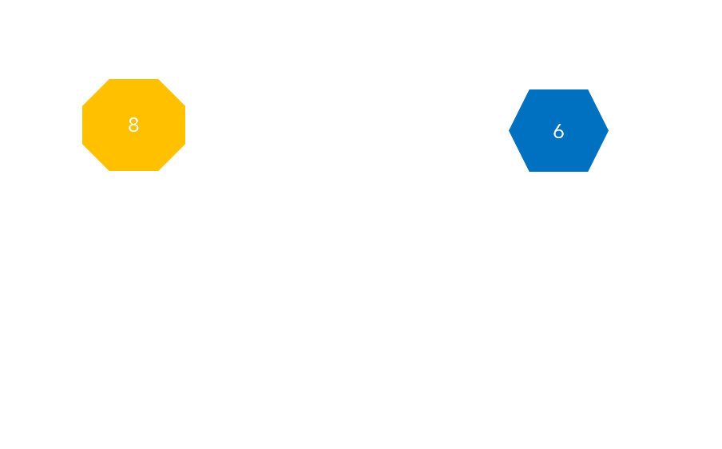
Checkpoints
Question
8
6
Student A’s answer
Checkpoint #2

Slide 37
Checkpoints
Question
8
6
Student A’s answer
Student B’s answer

Slide 38
Participants
#Host:Tutor
8
6
StudentA
StudentB

Slide 39
Checkpoints
Question
8
6
Student A’s answer
Student B’s answer

Slide 40
8
7

Slide 41
8
7
5

Slide 42
8
7
5

Slide 43
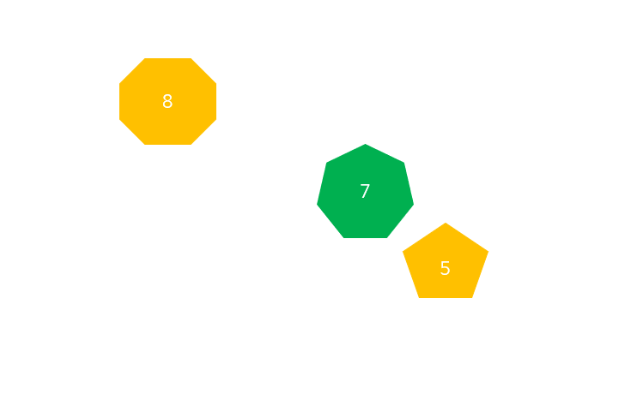
Checkpoints
Student A’s answer
8
7
Student B’s answer
5
Student A’s revised

Slide 44
8
6
4

Slide 45
8
6
4

Slide 46
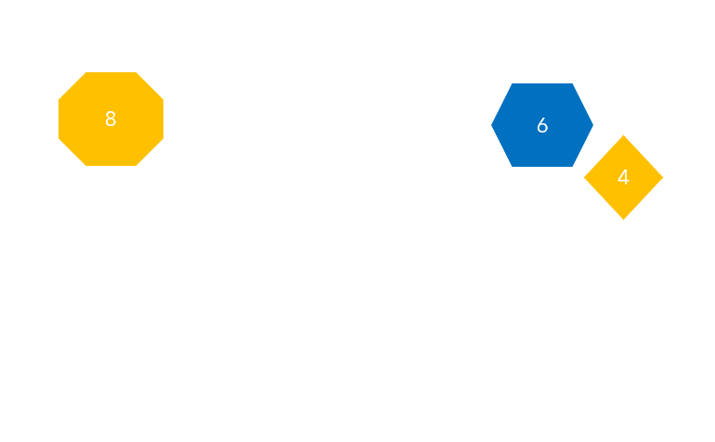
Checkpoints
Student B’s answer
8
6
4
Student A’s revised
Student B’s revised

